Slide 1
Procedures
Consider a procedure used to accumulate a sum:
int sum (int n, int acc) {
if (n > 0)
return sum(n – 1, acc + n);
else
return acc;
}
Consider the procedure call sum(3,0)
This will result in recursive calls to
sum(2,3)
sum(1,5)
sum(0,6)
and then the result 6 will be returned four times.
Notes:
This recursive call of sum is referred to as a tail call
No need to have a copy of the stack frame, just looping

Slide 2
Procedures
int sum (int n, int acc) {
if (n > 0)
return sum(n – 1, acc + n);
else
return acc;
}
sum:
slti $t0, $a0, 1 # test if n <= 0
bne $t0, $zero, sum_exit
add $a1, $a1, $a0 # add n to acc
addi $a0, $a0, –1 # subtract 1 from n
j sum # go to sum
sum_exit:
add $v0, $a1, $zero # return value acc
jr $ra # return to caller
Notes:
Assume $a0 = n and $a1 = acc
No need to have a copy of the stack frame, just looping

Slide 3
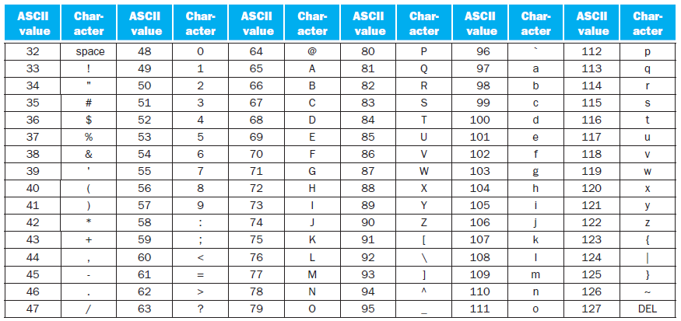
Communicating with People
Most computers today offer 8-bit bytes to represent characters, with the American Standard Code for Information Interchange (ASCII) being the representation that nearly everyone follows.

Slide 4
Communicating with People
Because of the popularity of text in some programs MIPS provides instructions to move bytes.
Load byte (lb) loads a byte from memory, placing it in the rightmost 8 bits of a register
  It treats the byte as a signed number and thus sign-extends to fill the 24 left most bits of the register (use lbu for unsigned)
Store byte (sb) takes a byte from the rightmost 8 bits of a register and writes it to memory (there is NO sbu)
lb $t0,0($sp) # Read byte from source
sb $t0,0($gp) # Write byte to destination
Notes:
Notice that there's no sbu (store byte unsigned). This is unnecessary since a single byte is being written to memory (thus, there's no sign extension to 32 bits, as there is when reading a byte into a 32-bit register).

Slide 5
Communicating with People
Characters are normally combined into strings. There are three choices for representing a string:
The first position of the string is reserved to give the length of a string
An accompanying variable has the length of the string (as in a structure)
The last position of a string is indicated by a character used to mark the end of a string
  Java uses the 1st option. Java includes a word that gives the length of the string, similar to Java arrays.
  C uses the 3rd choice, terminating a string with a byte whose value is 0 (named null in ASCII). Thus, the string “Cal” is represented in C by the following 4 bytes, shown as decimal numbers: 67, 97, 108, 0.

Slide 6
Communicating with People
The procedure strcpy copies string y to string x using the null byte termination convention of C:
void strcpy (char x[], char y[])
{
int i;
i = 0;
while ( ( x[i] = y[i] ) != ‘\0’ )
i += 1;
}
Notes:
Assume that base addresses for arrays x and y are found in $a0 and $a1, while i is in $s0

Slide 7
strcpy:
addi $sp,$sp,–4
sw $s0, 0($sp) # save $s0
add $s0,$zero,$zero # i = 0 + 0
L1:
add $t1,$s0,$a1 # address of y[i] in $t1
lbu $t2, 0($t1) # $t2 = y[i]
add $t3,$s0,$a0 # address of x[i] in $t3
sb $t2, 0($t3) # x[i] = y[i]
beq $t2,$zero,L2 # if y[i] == 0, go to L2
addi $s0, $s0,1 # i = i + 1
j L1 # go to L1
L2:
lw $s0, 0($sp) # y[i] == 0: end of string.
addi $sp,$sp,4 # pop 1 word off stack
jr $ra # return
void strcpy (char x[], char y[])
{
int i;
i = 0;
while ( ( x[i] = y[i] ) != ‘\0’ )
i += 1;
}
Assume that base addresses for arrays x and y are found in $a0 and $a1, while i is in $s0
Notes:
Since the procedure strcpy above is a leaf procedure, the compiler could allocate i to a temporary register and avoid saving and restoring $s0.
When a compiler finds a leaf procedure, it exhausts all temporary registers before using registers it must save.

Slide 8
Communicating with People
Unicode is a universal encoding of the alphabets of most human languages.
  There are almost as many alphabets in Unicode as there are useful symbols in ASCII.
Java uses Unicode for characters. By default, it uses 16 bits to represent a character.
  The MIPS instruction set has explicit instructions to load and store 16-bit quantities, called halfwords

Slide 9
Communicating with People
Load half (lh) loads a halfword from memory, placing it in the rightmost 16 bits of a register.
  Like load byte, load half (lh) treats the halfword as a signed number and thus sign-extends to fill the 16 left most bits of the register.
load halfword unsigned (lhu) works with unsigned integers.
Store half (sh) takes a halfword from the rightmost 16 bits of a register and writes it to memory.
lhu $t0,0($sp) # Read halfword (16 bits) from source
sh $t0,0($gp) # Write halfword (16 bits) to destination

Slide 10
Communicating with People
MIPS software tries to keep the stack aligned to word addresses, allowing the program to always use lw and sw (which must be aligned) to access the stack.
This convention means that a char variable allocated on the stack occupies 4 bytes, even though it needs less.
  However, a C string variable or an array of bytes will pack 4 bytes per word, and a Java string variable or array of shorts packs 2 halfwords per word.

Slide 11

Addressing in Branches and Jumps
The MIPS jump instructions have the simplest addressing.
They use the final MIPS instruction format, called the J-type, which consists of 6 bits for the operation field and the rest of the bits for the address field.
j 10000 # go to location 10000
Notes:
R-type and I-type and J-type
Where the value of the jump opcode is 2 and the jump address is 10000.
But it’s more complicated than this!

Slide 12
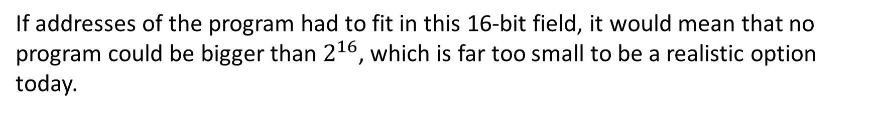
Addressing in Branches and Jumps
Unlike the jump instruction, the conditional branch instruction must specify two operands in addition to the branch address.
bne $s0,$s1,Exit # go to Exit if $s0 ≠ $s1
If addresses of the program had to fit in this 16-bit field, it would mean that no program could be bigger than $2^{16}$, which is far too small to be a realistic option today.

Slide 13
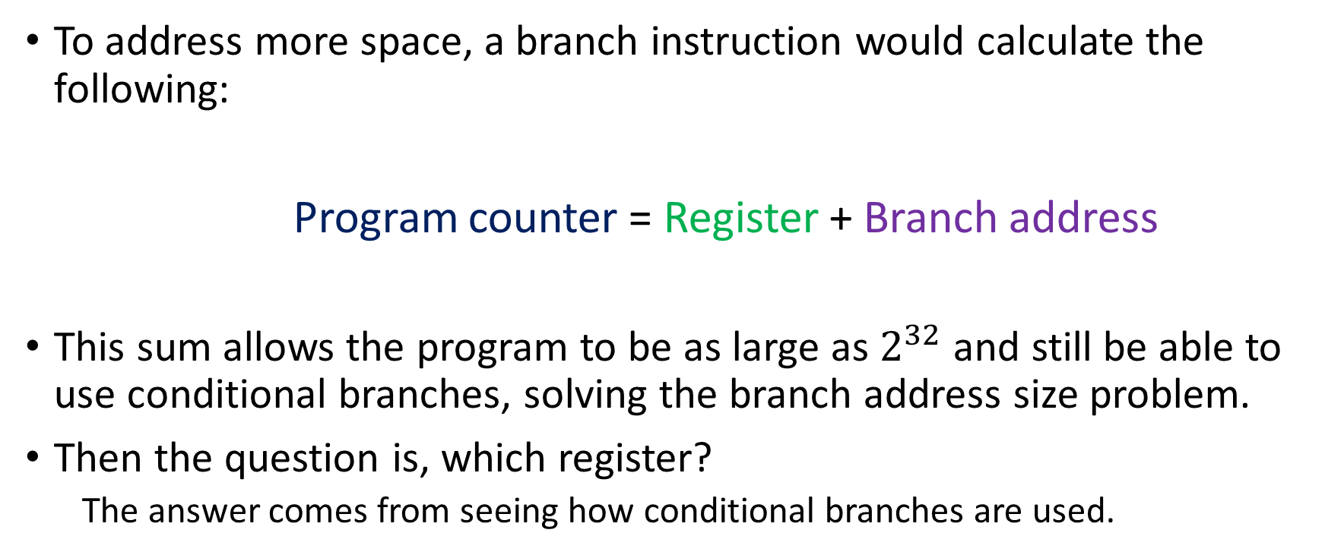
Addressing in Branches and Jumps
To address more space, a branch instruction would calculate the following:
Program counter = Register + Branch address
This sum allows the program to be as large as $2^{32}$ and still be able to use conditional branches, solving the branch address size problem.
Then the question is, which register?
  The answer comes from seeing how conditional branches are used.

Slide 14
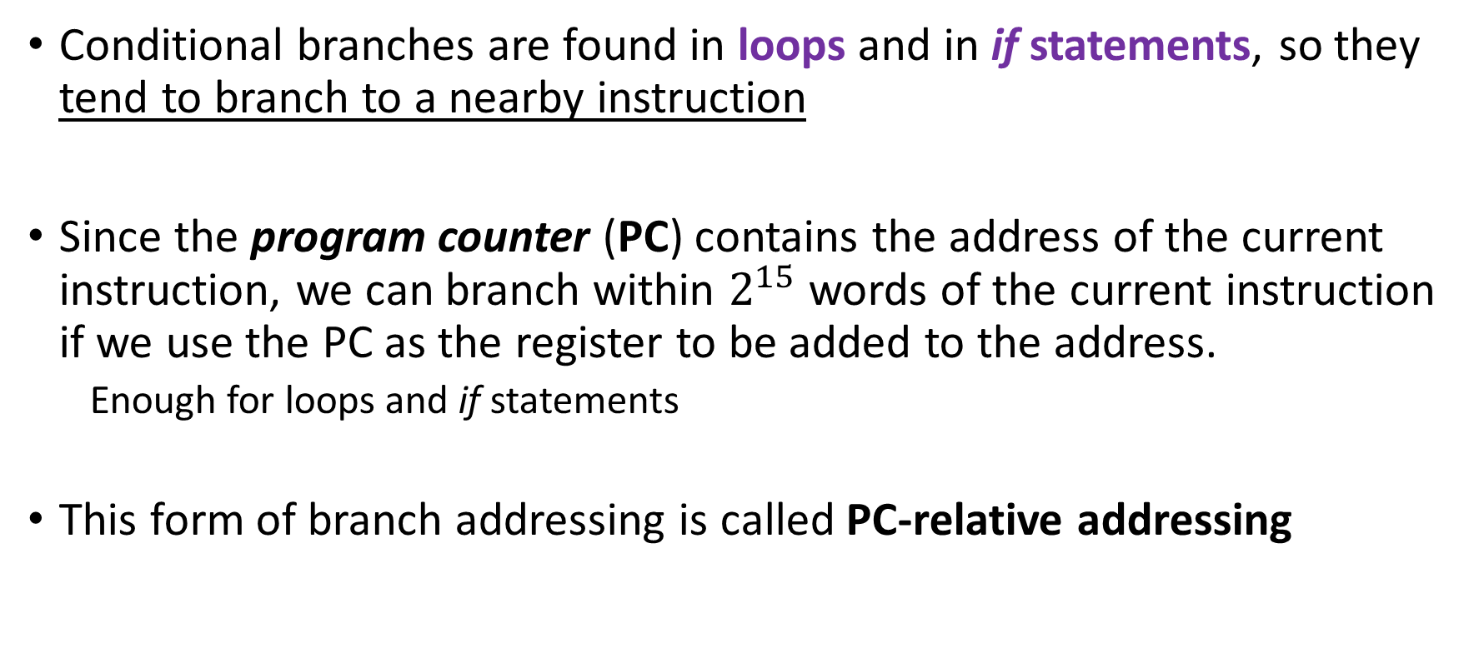
Addressing in Branches and Jumps
Conditional branches are found in loops and in if statements, so they tend to branch to a nearby instruction
Since the program counter (PC) contains the address of the current instruction, we can branch within $2^{15}$ words of the current instruction if we use the PC as the register to be added to the address.
  Enough for loops and if statements
This form of branch addressing is called PC-relative addressing

Slide 15
Addressing in Branches and Jumps
On the other hand, jump-and-link instructions need to address anywhere in memory!
So, in MIPS we have the J-type format for both jump and jump-and-link instructions

Slide 16
Addressing in Branches and Jumps
Since all MIPS instructions are 4 bytes long:
MIPS stretches the distance of the branch by having PC-relative addressing refer to the number of words to the next instruction instead of the number of bytes.

Slide 17
Addressing in Branches and Jumps
Thus, the 16-bit field represents a 18-bit byte address
Similarly, the 26-bit field in jump instructions is also a word address, meaning that it represents a 28-bit byte address

Slide 18
Addressing in Branches and Jumps
Since the PC is 32 bits, and not 28, 4 bits must come from somewhere else for jumps.
The MIPS jump instruction replaces only the lower 28 bits of the PC, leaving the upper 4 bits of the PC unchanged.
The loader and linker must be careful to avoid placing a program across an address boundary of 256 MB (64 million instructions)
Otherwise, a jump must be replaced by a jump register instruction preceded by other instructions to load the full 32-bit address into a register

Slide 19
Addressing in Branches and Jumps
A trick: Given a branch on register $s0 being equal to register $s1
beq $s0, $s1, L1
Replace it by a pair of instructions that offers a much greater branching distance.
bne $s0, $s1, L2
j L1
L2:

Slide 20

MIPS Addressing Mode Summary
Multiple forms of addressing are generically called addressing modes. modes are the following:
Immediate addressing, where the operand is a constant within the instruction itself

Slide 21
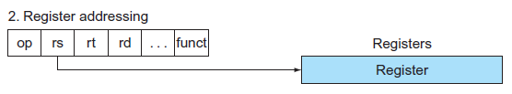
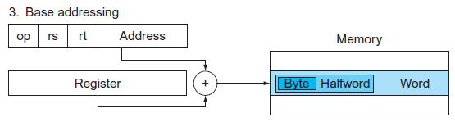
MIPS Addressing Mode Summary
Register addressing, where the operand is a register
Base or displacement addressing, where the operand is at the memory location whose address is the sum of a register and a constant in the instruction

Slide 22
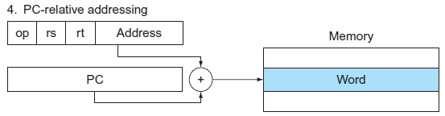
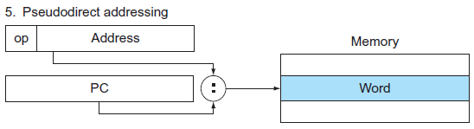
MIPS Addressing Mode Summary
PC-relative addressing, where the branch address is the sum of the PC and a constant in the instruction
Pseudodirect addressing, where the jump address is the 26 bits of the instruction concatenated with the upper bits of the PC

Slide 23
MIPS Addressing Mode Summary
Although we show MIPS as having 32-bit addresses, nearly all microprocessors (including MIPS) have 64-bit address extensions
These extensions were in response to the needs of software for larger programs.
The process of instruction set extension allows architectures to expand in such a way that is able to move software compatibly upward to the next generation of architecture.

Slide 24
Translating and Starting a Program
We now describe the four steps in transforming a C program in a file on disk into a program running on a computer.
Compiler
Assembler
Linker
Loader
Some systems combine these steps to reduce translation time, but these are the logical four phases that programs go through.

Slide 25
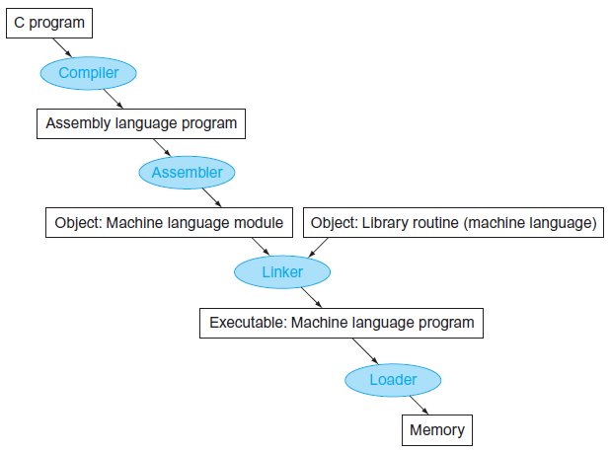

Slide 26
Compiler
The compiler transforms the C program into an assembly language program, a symbolic form of what the machine understands.
In 1975, many operating systems and assemblers were written in assembly language because memories were small and compilers were inefficient.

Slide 27
Assembler
The assembler turns the assembly language program into an object file, which is a combination of machine language instructions, data, and information needed to place instructions properly in memory.
It determines the addresses corresponding to all labels.
  Assemblers keep track of labels used in branches and data transfer instructions in a symbol table.

Slide 28
Assembler
The object file for UNIX systems typically contains six distinct pieces:
The object file header describes the size and position of the other pieces of the object file.
The text segment contains the machine language code.
The static data segment contains data allocated for the life of the program (static and dynamic data)
The relocation information identifies instructions and data words that depend on absolute addresses when the program is loaded into memory.
The symbol table contains the remaining labels that are not defined, such as external references.
The debugging information contains a concise description of how the modules were compiled so that a debugger can associate machine instructions with C source files and make data structures readable

Slide 29
Linker
A link editor or linker takes all the independently assembled machine language programs and “stitches” them together.
There are three steps for the linker:
Place code and data modules symbolically in memory.
Determine the addresses of data and instruction labels.
Patch both the internal and external references.

Slide 30
Linker
The linker uses the relocation information and symbol table in each object module to resolve all undefined labels.
It finds the old addresses and replaces them with the new addresses.
Editing is the origin of the name “link editor,” or linker for short.
The reason a linker is useful is that it is much faster to patch code than it is to recompile and reassemble.

Slide 31
Linker
If all external references are resolved, the linker next determines the memory locations each module will occupy.
MIPS allocates program and data to memory.
When the linker places a module in memory, all absolute references, that is, memory addresses that are not relative to a register, must be relocated to reflect its true location.

Slide 32
Linker
The linker produces an executable file that can be run on a computer.
Typically, this file has the same format as an object file, except that it contains no unresolved references.
It is possible to have partially linked files, such as library routines, that still have unresolved addresses and hence result in object files.

Slide 33
Loader
Now that the executable file is on disk, the operating system reads it to memory and starts it. The loader follows these steps in UNIX systems:
Reads the executable file header to determine size of the text and data segments.
Creates an address space large enough for the text and data.
Copies the instructions and data from the executable file into memory.
Copies the parameters (if any) to the main program onto the stack.
Initializes the machine registers and sets the stack pointer to the first free location.
Jumps to a start-up routine that copies the parameters into the argument registers and calls the main routine of the program. When the main routine returns, the start-up routine terminates the program with an exit system call

